Slide 1
Make a Nice Chinese Meal
EDCI-337
Assignment 4
Jin Xue& Wei Wang

Slide 2
Intro
Since Chinese students live abroad for a few years, we find Chinese food is the most popular food in the world. When we go to Chinses restaurant, there are not only Chinese in, also other countries people.

Slide 3
Plan
There are eight major cuisines in Chinese cuisine, each stemming from the different cultural backgrounds of each region. This course focuses on one main dish and two side dishes as examples to give students an understanding of Chinese food culture.

Slide 4
Plan
The main focus of our lesson is to teach a classical Chinese meal.
-Beijing Bean Sauce Fried Noodles（炸酱面）
-Spicy and sour chicken feet（酸辣鸡爪）
-Mapo Tofu（麻婆豆腐）is part of Sichuan cuisine.

Slide 5
Learning Outcomes
By the end of this course, students should be able to:
Remember the order of each step
Know the spices needed for each dish
Know the amount of spices to use
Able to try three dishes on their own

Slide 6
Beijing Fried Bean Sauce Noodle（北京炸酱面）

Slide 7
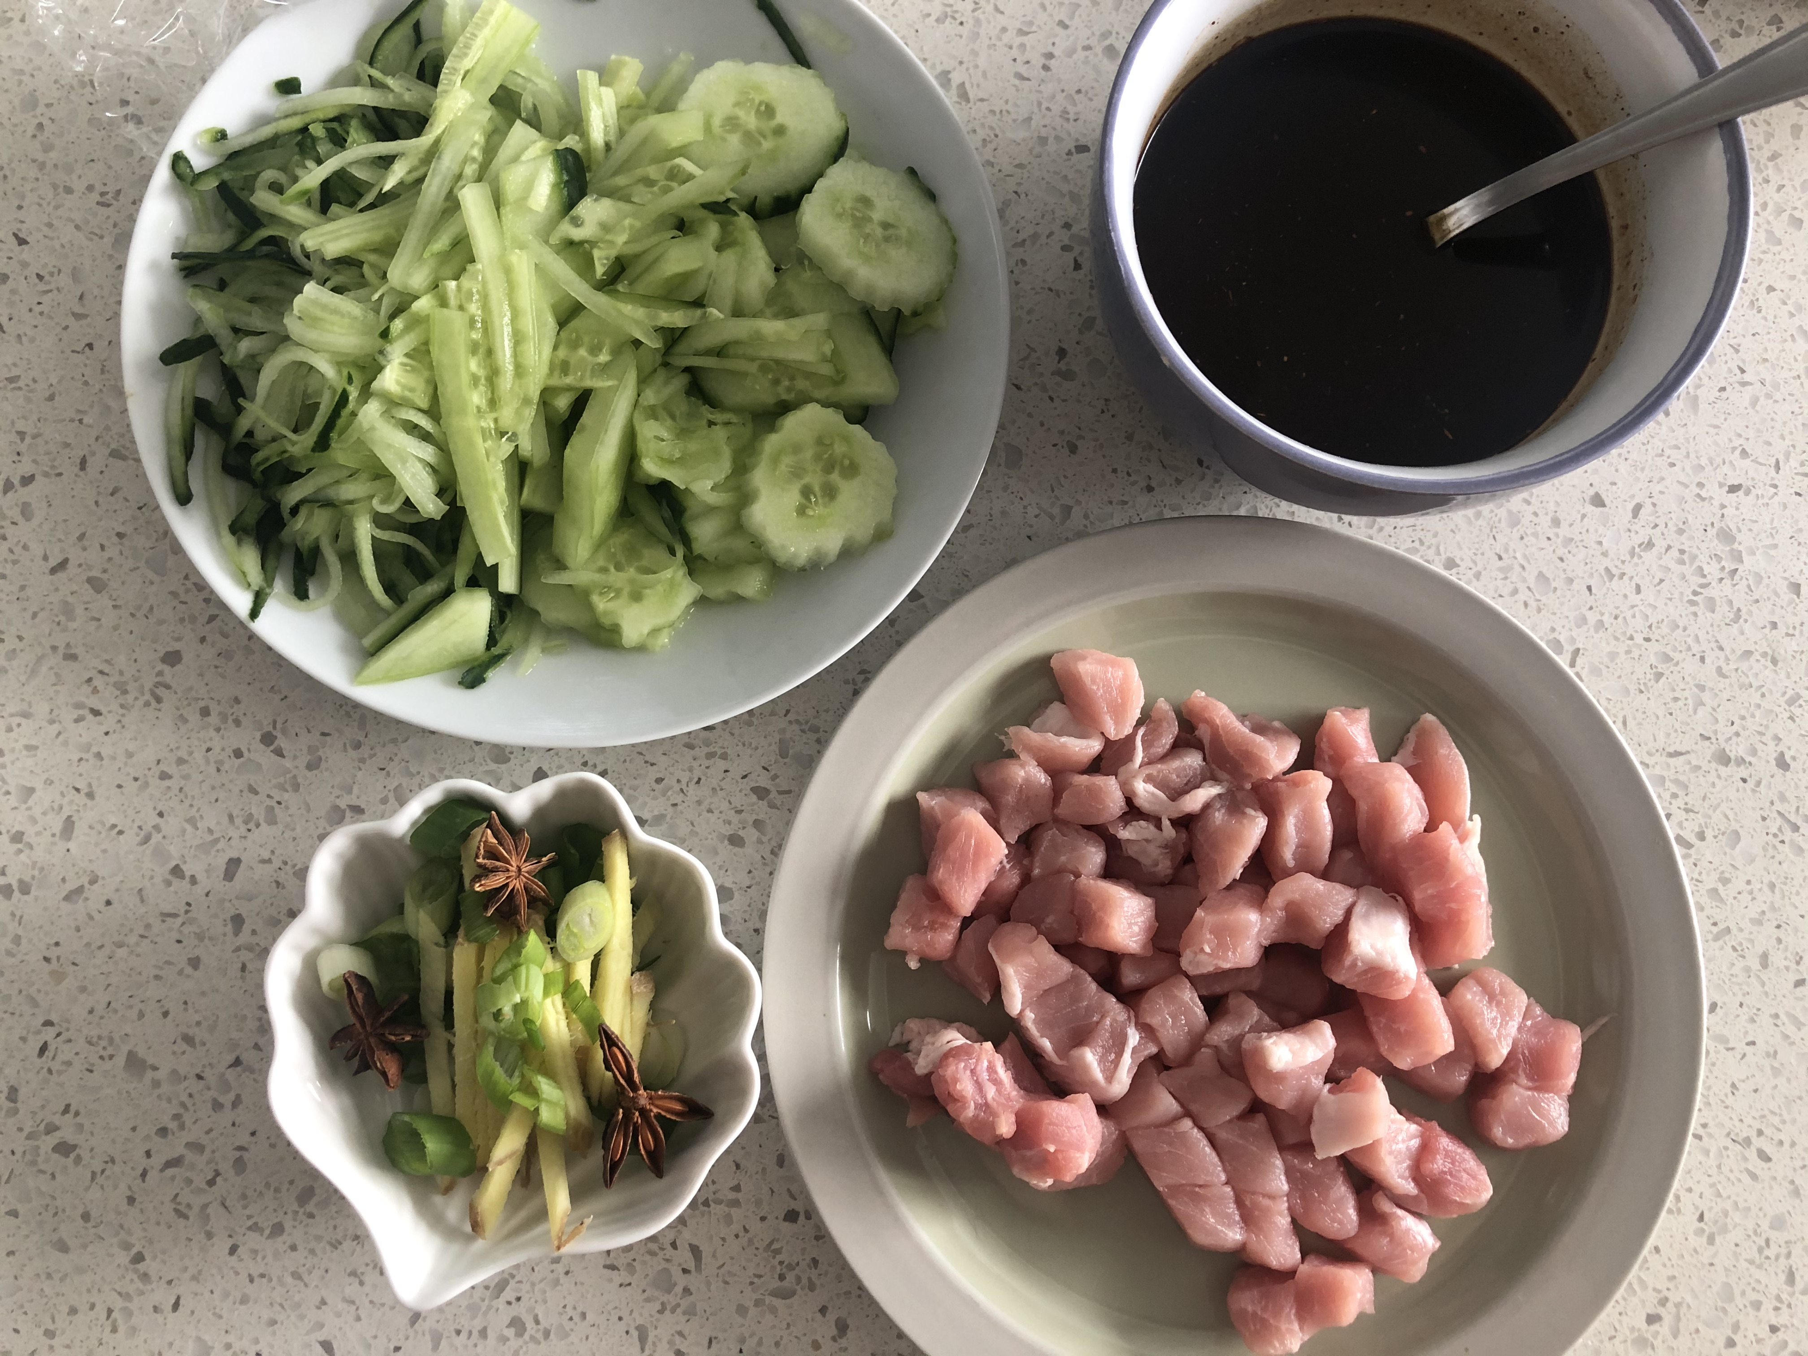
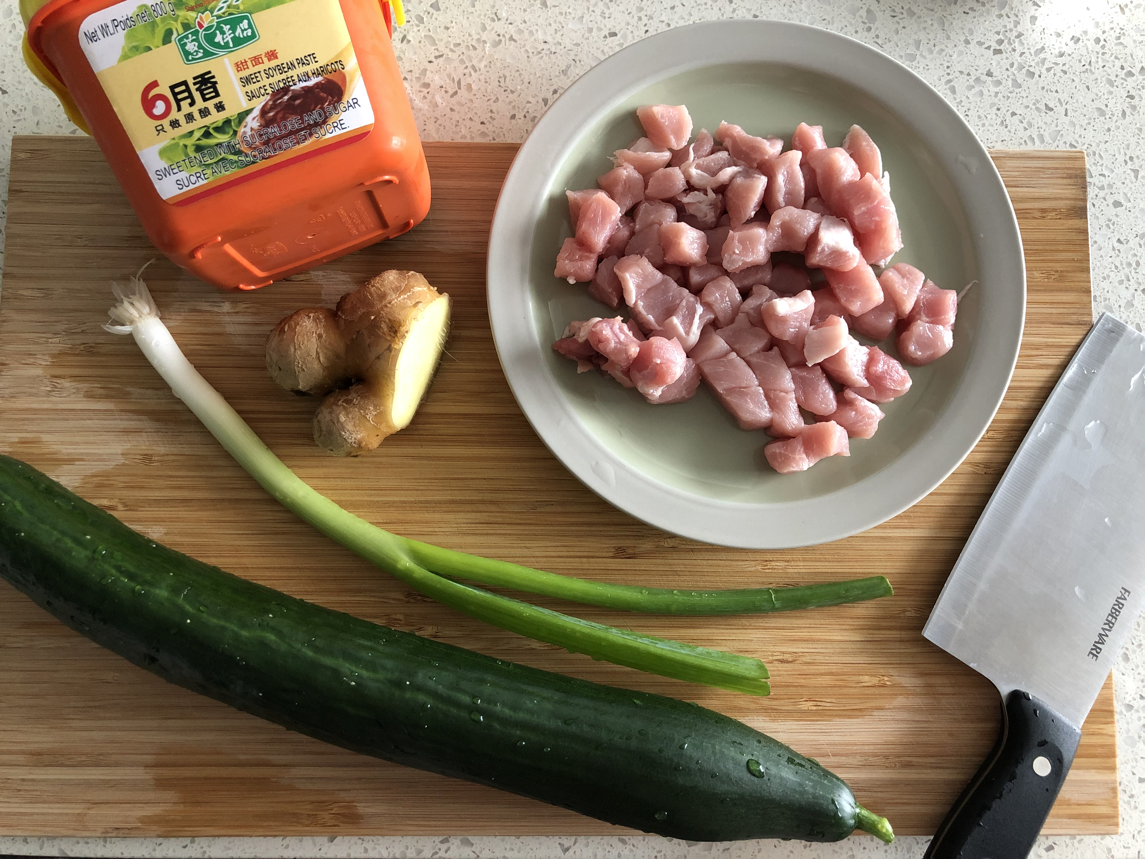
Ingredient
Noodle
Cucumber(julienned)
Pork(diced)
Sweet Soybean Sauce
Green Onion
Ginger
Star Anise

Slide 8
Step
Mix: Two spoons of sweet soybean sauce and soy sauce, one spoons of dark soy sauce and oyster sauce, half spoon of sugar and Chinese spice powder, half bowl of water.
Heat up oil. Add star anise, green onion, and ginger. Wait until the fragrant and pour the diced pork.
Pour the mixed sauce until the pork becomes pale.
About 20 minutes, the sauce will be ready.
Top the vegetable and sauce on the noodle.

Slide 9
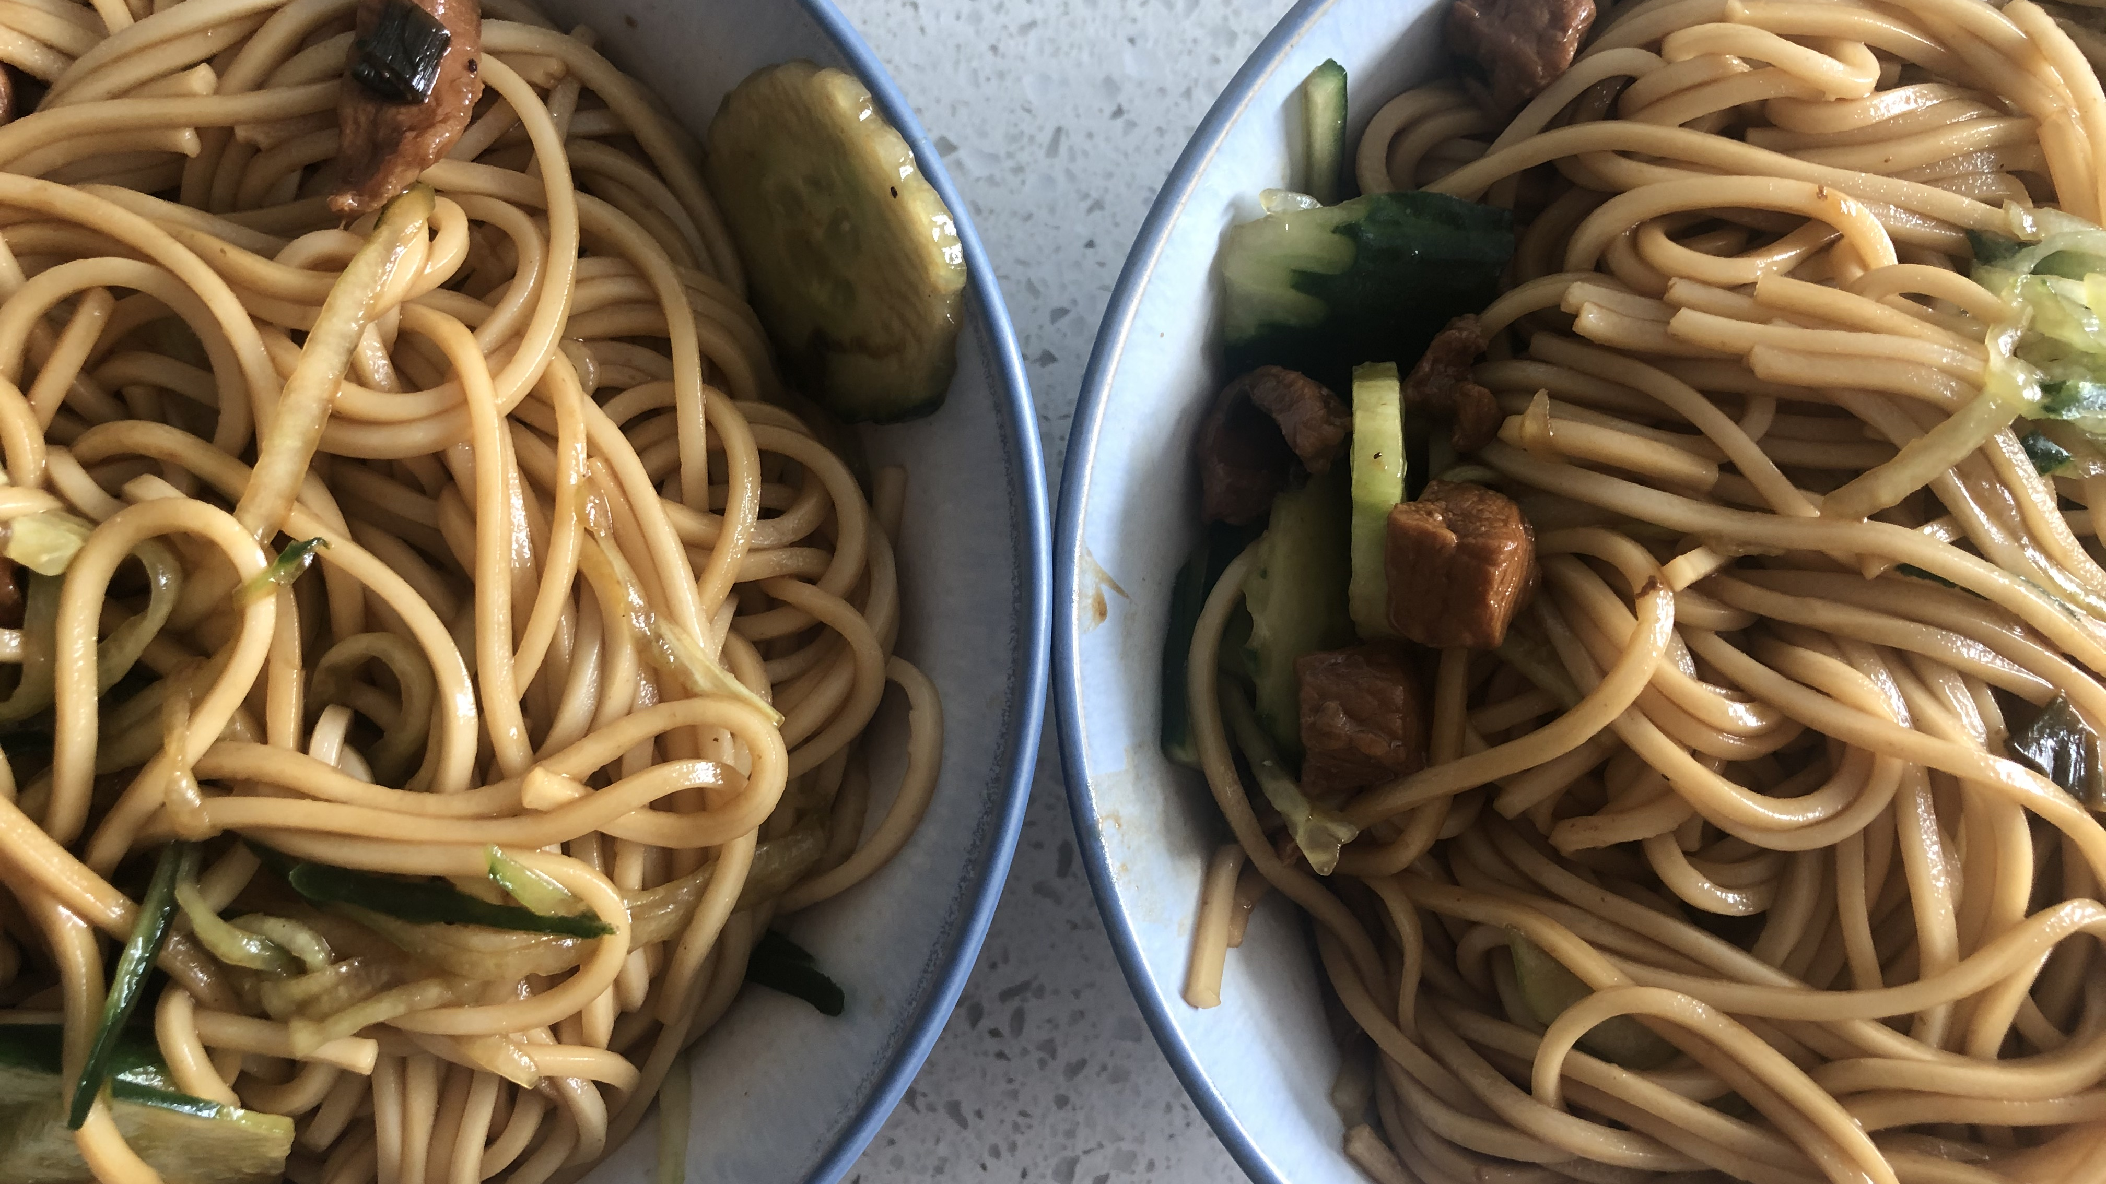
Beijing Fried Bean Sauce Noodle

Slide 10
Sour and Spicy Chicken Feet（酸辣鸡爪）

Slide 11
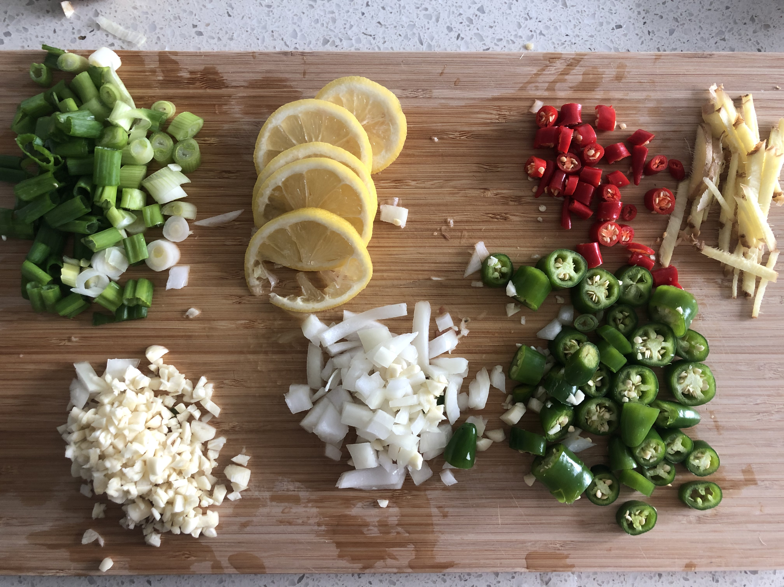
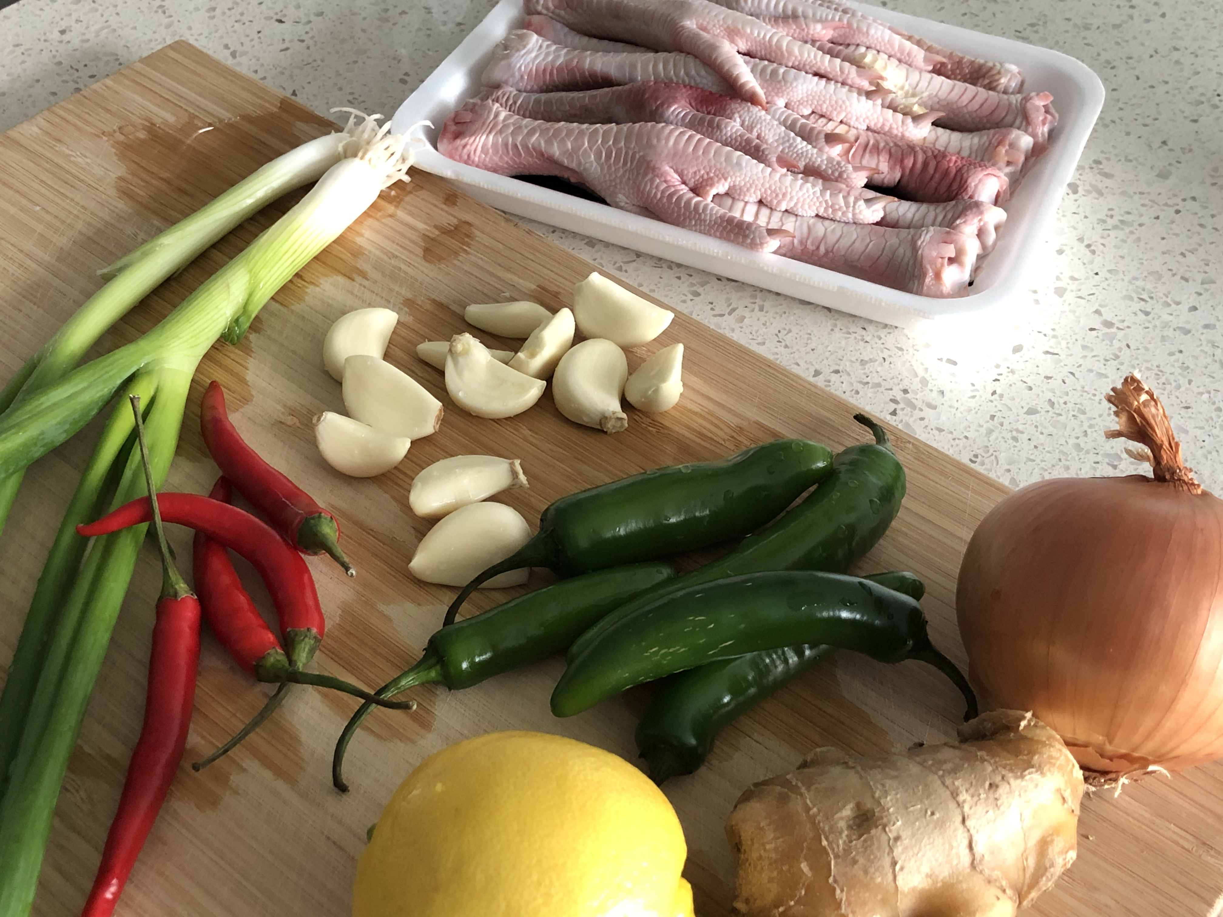
Ingredient
Chicken feet
Lemon
Onion
Green onion
Ginger
Garlic
Chili
Green Pepper

Slide 12
Step
The chicken feet are cut in half after cutting off the nails.
Put cold water in the pot, add chicken feet, add ginger slices and cooking wine and cook until the water is boiling. Cook for 15-20minutes. At the same time, chili, garlic mince, lemon slice, onion mince, green pepper mince add vinegar, salt, sugar, sesame oil and mix into a bowl of sauce.
The cooked chicken feet are taken out and immersed in ice water. This step is very important. The chicken feet made in this way will be more vigorous.

Slide 13
Step
Drain the chicken feet, add Sauce and mix well.
The mixed chicken feet are placed in a container, sealed, and then refrigerated for 2-4 hours. They are usually marinated overnight to add flavor.
Now is ready!

Slide 14
Sour and Spicy Chicken Feet

Slide 15
Mapo ToFu (麻婆豆腐）

Slide 16
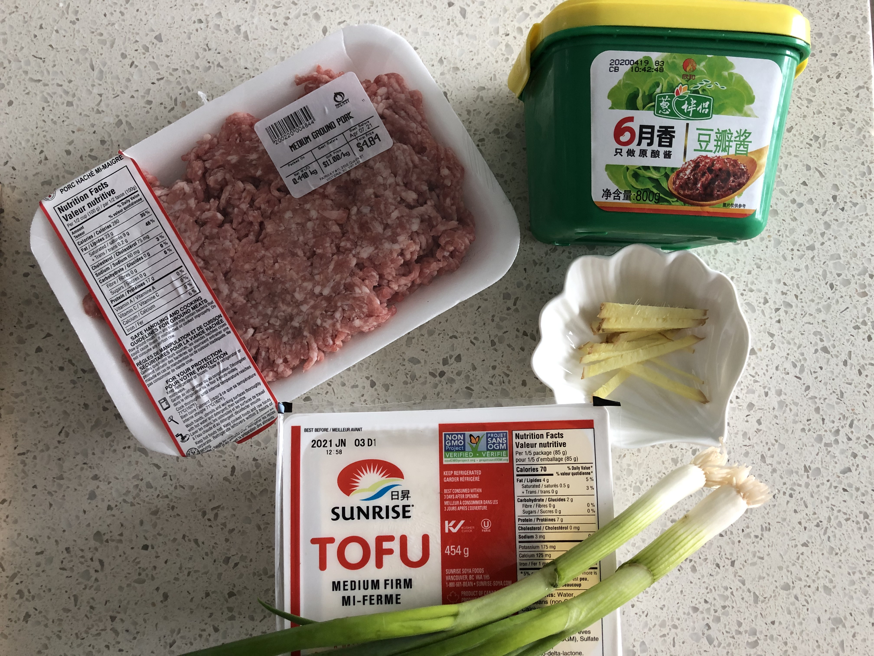
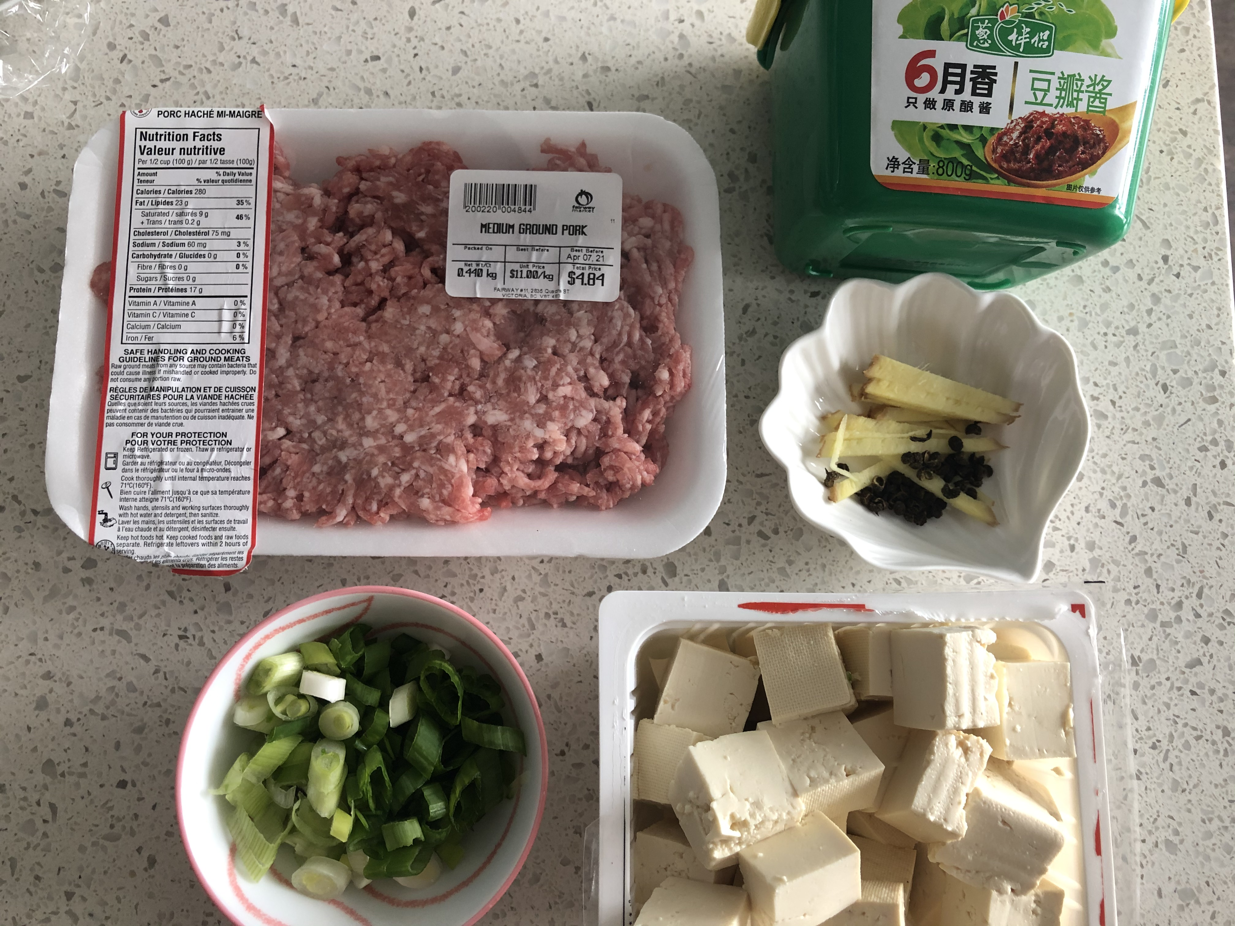
Ingredient
Tofu
Pork(minced)
Spicy Sauce (Doubanjiang)
Chili powder
Green onion
Ginger
Pepper Corns

Slide 17
Step
Heat up oil. Add pepper corn and wait until fragrant.
Pour the pork with green onion, ginger, spicy sauce.
Pour Tofu and add half bowl of water. Add chili powder, soy sauce, sugar. Wait 5 minutes and add green onion again.
Wait 2 minutes, the dish is ready!

Slide 18
MAPO TOFU

Slide 19
HAPPY MEAL

